Slide 1
Lecture 22
Notification

Slide 2
Notification Manager
Android allows to put notification into the title-bar of your application.
The user can expand the notification bar.
By selecting the notification the user can trigger another activity.
Because notifications can be very annoying, the user can disable notifications for each application from “Settings”.
Apps in the Settings, select the app you are interested in and unset the Show notifications checkbox to prevent the app to show notifications.

Slide 3
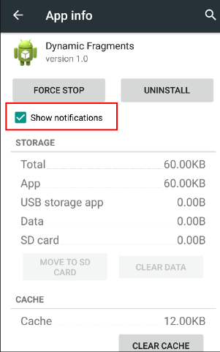
Notification Manager

Slide 4
Setting up Notifications
To create notifications use NotificationManager
class by this Syntax:-
NotificationManager nm=
(NotificationManager)getSystemService(Context.NOTIFICATION_SERVICE);
You can call the cancel() method for Canceling a Notification.
cancelAll() method call removes all notifications.

Slide 5
Pending Intent
A pending intent is a token that you give to another application. Like:- notification manager, alarm manager or other 3rd party applications.
It allows other application to use the permissions of your application to execute a predefined piece of code.
To perform an activity by pending intent, you receive the activity by PendingIntent.getActivity().

Slide 6
How to Create Notification?
Take a Project by name “NotificationApp”.
It will Provide you a XML file by name “activity_main” and a Java File by name “MainActivity”.
Now take, Another java file by Name “NotificationResult” and another XML file by name “activity_notification”.
Provide reference of Second java file in “AndroidManifast.xml” file by using <activity> tag.

Slide 7
How to Create Notification?
Take a TextView in second xml file “activity_notification” and Put text “Welcome”.
Link your Second XML file “activity_notification with your second java file “NotificationResult” by using this code:-
public class NotificationResult extends Activity{
protected void onCreate(Bundle savedInstanceState) {
super.onCreate(savedInstanceState);
setContentView(R.layout.activity_notification);
}
}

Slide 8
Code of MainActivity.java
public class MainActivity extends Activity {
Integer NOTIFY_ID=1337;
protected void onCreate(Bundle savedInstanceState) {
super.onCreate(savedInstanceState);
setContentView(R.layout.activity_main);
NotificationManager nm = (NotificationManager)getSystemService(Context.NOTIFICATION_SERVICE);
Notification note=new Notification(R.drawable.ic_launcher, “Any message",System.currentTimeMillis());
ICON of Notification Ticket Text When Will be Execute
Intent i = new Intent(getApplicationContext(), NotificationResult.class);
// This pending intent will open after notification click
PendingIntent pi=PendingIntent.getActivity(this, 0, I , 0);
Context Request Code Intent Flag
// Set Title and Message for Notification
note.setLatestEventInfo(this, "Android Notification Title","This is the android notification message", pi);
// Create Notification
nm.notify(NOTIFY_ID, note);
}
}

Slide 9
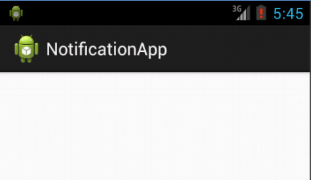
Output
When we run this Project then Notification will be created:-

Slide 10
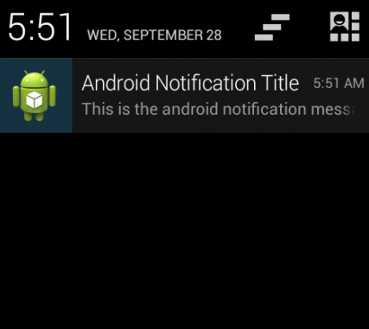
Output
When we open notification window then it will show Notification Title, Notification Message with Notification Icon Image.

Slide 11
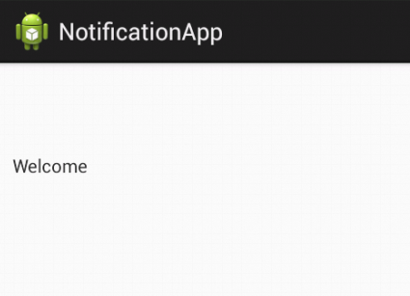
Output
When we click on Our Notification then it will execute our second activity “NotificationResult”.

